Slide 1
Deep Learning for Remote Sensing Floodnet Classification
Arjun Arora
Data Science

Slide 2

Outline
Introduction
Motivation & Objective
Post disaster visual scene understanding
Floodnet dataset & Classification
Data preparation & preprocessing
Model training
Transfer learning
Experimental setup & Parameters
Results and predictions
Conclusion
Future works and tasks
References

Slide 3
Introduction
How can computer vision help in Disaster Management?
Rapid floods more common due to climate change
Fig 1: Pakistan floods drone images

Slide 4
Introduction
How can computer vision help in Disaster Management?
Accurate, timely and understandable information - quick response and recovery on large scale.
Fig 2: Computer vision in action

Slide 5
Introduction
Computer vision can help in visual scene understanding post disaster.
Unmanned Aerial Vehicle(UAV) - access, cheap, HQ images.
Tasks: Classification, Image Segmentation, Visual Question Answering.
Deep learning algorithms can analyse the impact of any disaster.
Understanding of the affected areas and plan the response.

Slide 6
Fig 3: Disaster detection by deep learning

Slide 7
Motivation
Recent decades, floods are much more common.
Hurricane Katrina (Florida and Louisiana, August 2005), Hurricane Leslie (France, October 2018), the 2018 monsoon season in India (Kerala, August 2018) and the floods in Pakistan right now
Fig 4: Deadliest natural disasters

Slide 8
Motivation
Drone is a great tool in mapping, search and rescue, transportation and training.
Unmanned, easy, safe, HQ images.
Provides data for quick response in the affected areas.
NEED: Deep learning models to automatically flag high priority areas post disaster
Fig 5: Flood mapping using drones

Slide 9
Post disaster visual scene understanding
Classification - Flooded vs Non-Flooded
Semantic segmentation - flooded roads, buildings, natural water
Visual question answering -
What is the overall condition of the given image?
How many buildings are flooded?
Condition of the road in this image?
Fig 6: Some examples from Floodnet

Slide 10
Post disaster visual scene understanding- Classification
Supervised classification - Imagenet, ResNet, EfficientNet
ResNet - Residual connection architecture; Skip connections solve vanishing gradient.
EfficientNet - Simple but scalable
Table 1: Authors classification results

Slide 11
Post disaster visual scene understanding- Semantic segmentation
Supervised Semantic Segmentation: Extract max info from image.
Classify each pixel to a class label.
Models - UNet, PSPNet and DeepLab.
Table 2: Segmentation classes

Slide 12
Post disaster visual scene understanding- VQA
VQA framework: Generate questions related to building, road, and entire image.
Precise damages and situations.
Find right questions and multiple for each image.
Challenge: Annotation is difficult

Slide 13
Floodnet Dataset
Source - small DJI UAV drone after Hurricane Harvey, 2017.
Images taken during response - realistic and state of practice.
High resolution images ~ 4/5 Megabytes.
1450 train images (2343 total)
400 images are labeled.
Our sample set: Train labeled images (51 Flooded, 357 Non-flooded)

Slide 14
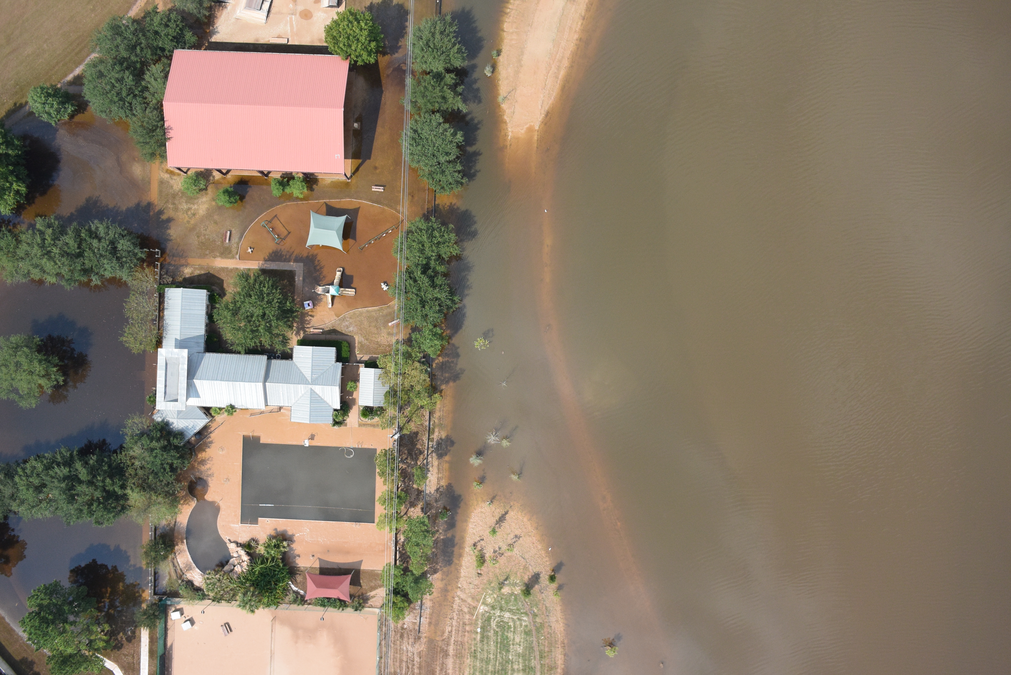
Floodnet Dataset - Challenges
Labeled data samples are small.
Images are very high resolution, difficult to process.
Resize without loss of efficiency.
Natural water bodies
Fig 7: Data sample

Slide 15
Floodnet Classification
Classifying hurricane Harvey images as Flooded or Non-Flooded
Fig 8: Image classifier

Slide 16
Floodnet Classification
Classifying hurricane Harvey images as Flooded or Non-Flooded
Steps taken for efficient and accurate classifications:
Resize the images.
Split dataset to train, test and validation sets.
Use ImageDataGenerator - Augmentation and batches.
Use transfer learning(Resnet 50)
Test on batches of images.
Use tensor-board for visualisation and experimentation.

Slide 17
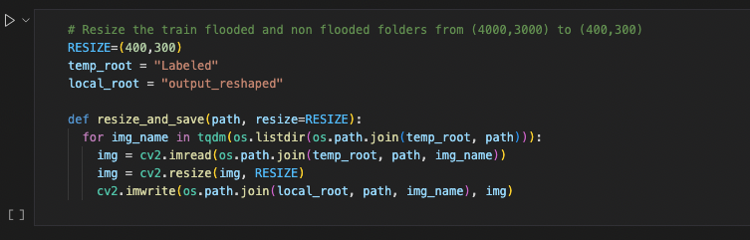
Data preparation & preprocessing
Resize the images: OG image size ~ 7 MBs. Difficult to work with. Large number of parameters working with 4000*3000 pixel images.
Ram over crashes.
Solution! Reshape to 400*300
Fig 9: Resize the images

Slide 18
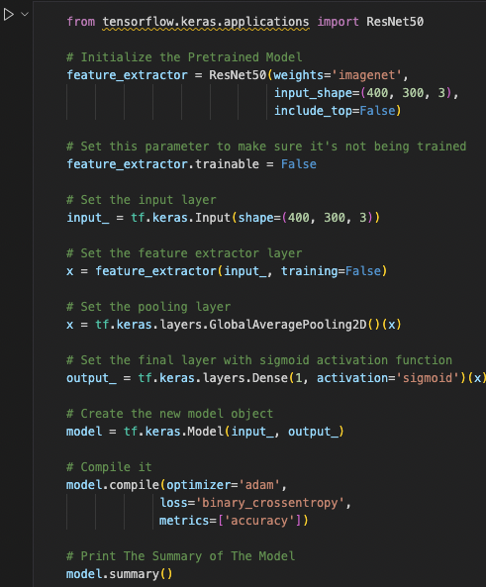
Model - ResNet
Deep residual networks(ResNet-50): 50 layer deep CNN.
Stacks residual blocks on top of each other to form a network.
Pretrained on ImageNet database.
Output layer with sigmoid activation function.
Fig 10: Model preparation

Slide 19
Model - Components
Fig 11: Image classification with conv nets

Slide 20
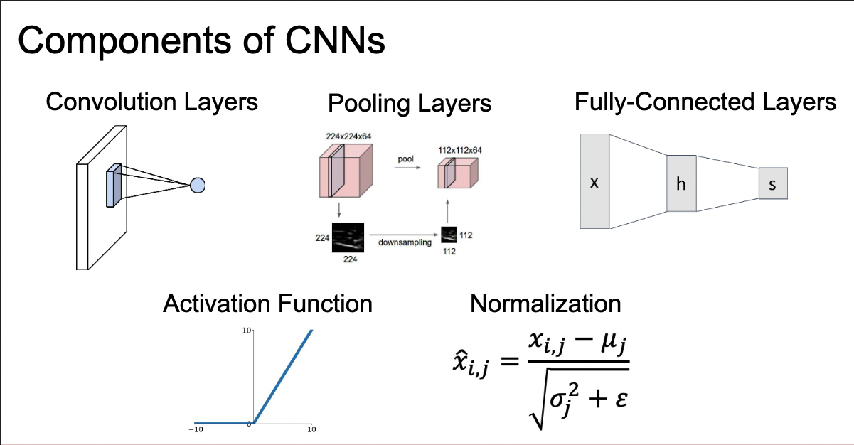
Model - Components
Fig 12: Components of CNN

Slide 21
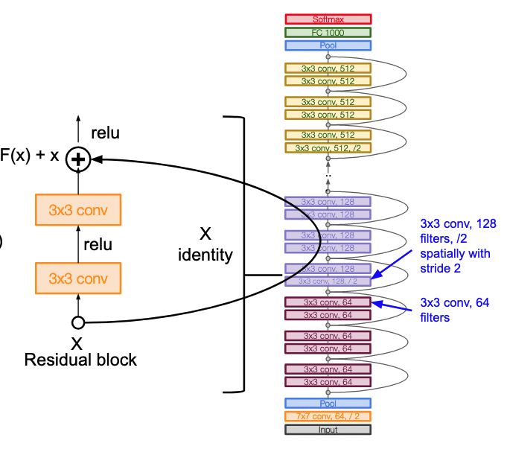
Model - Architecture
Fig 13: Resnet Architecture

Slide 22
Model - Imagenet
ImageNet - 14 million images into 1000 object categories.
Used in visual object detection since 2010.
A lot of major CNNs have used this dataset to train.
These networks also demonstrate a strong ability to generalise to images outside the ImageNet dataset via transfer learning, such as feature extraction and fine-tuning.
Fig 14 :Imagenet examples

Slide 23
Transfer Learning
Fig 15: Transfer learning

Slide 24
Transfer Learning
Reuse pre-trained model on a new problem.
Little data, quick train times.
Used in Computer vision and NLP.
You need to add/modify some layers according to the new task.
Fig 16: Learning transfer from old task to new task

Slide 25
Experimental setup
Train - 80%, test - 10%, val - 10%.
Labels 1 for Flooded, 0 for Non-flooded.
Input layer + Resnet50 feature extraction layer + Global average pooling layer + Output layer with sigmoid activation.
Integrated Feature Extractor: The pre-trained model, or some portion of the model, is integrated into a new model, but layers of the pre-trained model are frozen during training.

Slide 26
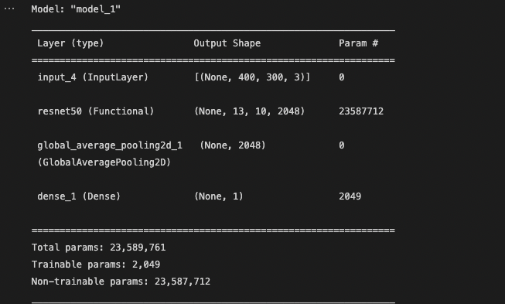
Experimental setup - Model Summary
Fig 17: Model summary

Slide 27
Experimental setup - Layers
GlobalAveragePooling layer - Replace fully connected layer. Take average of each feature map and the result is fed directly to activation.
Sigmoid activation function - Only two classes so like 2-element softmax. Output always between 0 and 1.
Adam optimiser, binary cross_entropy and metrics.
Fig 18: Sigmoid function

Slide 28
Experimental setup - Model compile
Optimiser - Adam optimisation is a stochastic gradient descent method that is based on adaptive estimation of first-order and second-order moments.
Loss function - Binary crossentropy, binary classification tasks.
Metrics - Acuuracy. Pred vs actual match. Total and count. Binary accuracy.
Fig 19: Binary crossentropy

Slide 29
Results - Train & Val
Fig 20: Accuracy and Loss trends

Slide 30
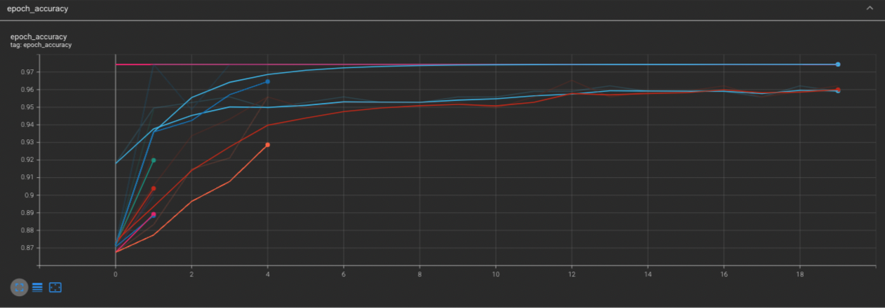
Results - Tensorboard
Fig 21: Accuracy trend

Slide 31
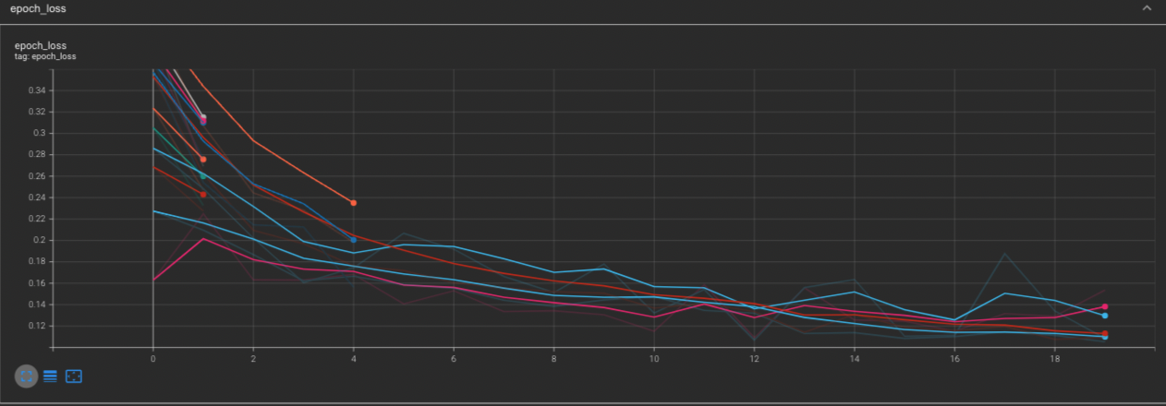
Results - Tensorboard
Fig 22: Loss trend

Slide 32
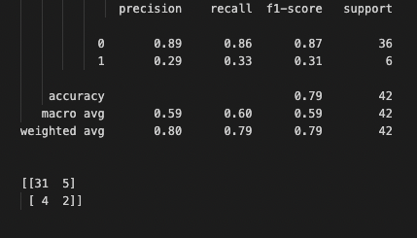
Results - Test data
Fig 23: Test accuracy metrics

Slide 33
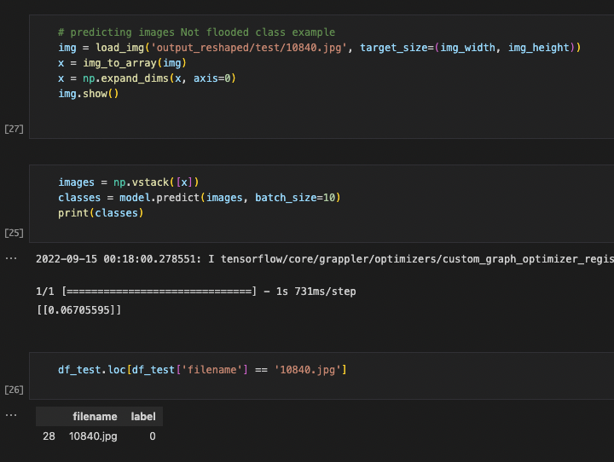
Results - Examples
Fig 24: Non-Flooded example

Slide 34
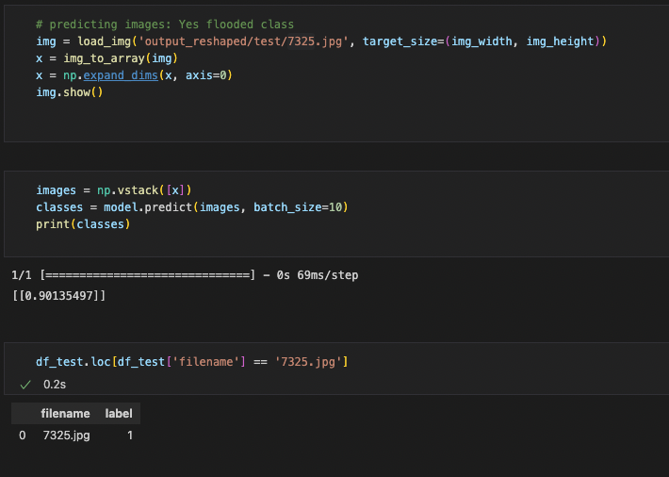
Results - Examples
Fig 25: Flooded example

Slide 35
Summary
Results achieved above 95% accuracy for Train and Validation.
80% accuracy for test data.
Model performed well even for small number of examples using transfer learning.
Training times low due to reshaping the data.
Computationally efficient.
Examples show reliably accuracy in practical settings.

Slide 36
Future works
Use non-labeled data for training using Semi-supervised techniques.
Right now we used only around 400 images, total data available > 2000 HQ images.
Use max info from the images in further tasks like Semantic segmentation which requires pixel-wise details.
VQA can also be performed and tested against author’s results.

Slide 37
References
https://www.climatechange.ai/papers/neurips2021/55
https://arxiv.org/pdf/2012.02951.pdf
https://arxiv.org/pdf/2105.08655.pdf
https://github.com/BinaLab/FloodNet-Challenge-EARTHVISION2021
https://github.com/sahilkhose/FloodNet
https://machinelearningmastery.com/how-to-use-transfer-learning-when-developing-convolutional-neural-network-models/
http://cs231n.stanford.edu/schedule.html

